Slide 1

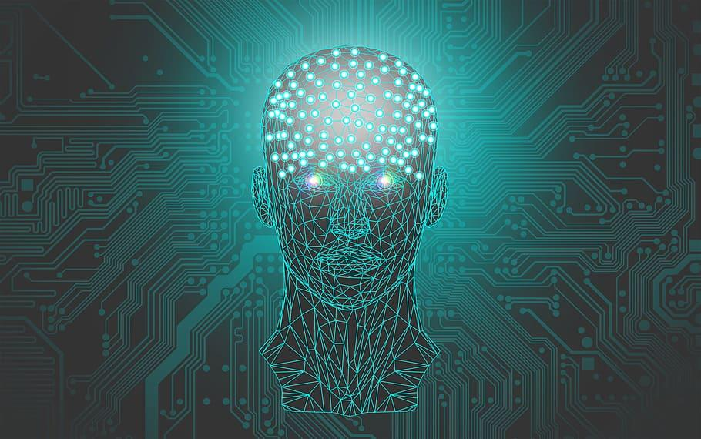
ARTIFICIAL INTELLIGENCE RECOMMENDATION SYSTEM FOR CANCER REHABILITATION SCHEME
DEPARTMENTT OF CSE
BATCH-12
S.NIVETHANARAYANI (211417104173)
PALAGIRI VAISHNAVI (211417104177)
RAMYAPRABA (211417104221)
PROJECT GUIDE
MRS.P.VIJAYALAKSHMI
ASSOCIATE PROFESSOR

Slide 2
INTRODUCTION
Cancer is a group of diseases characterized by the uncontrollable growth and rapid spread of abnormal cells which damages the nearby healthy tissues of brain.
In this system, we propose machine learning strategies to improve cancer characterization, Inspired by learning from CNN approaches.
MRI(Magnetic Resonance Imaging) is a widely used imaging technique to diagnose these tumors.
But the large amount of data produced by MRI needs manual Segmentation in a reasonable time.
To reduce time and manual power, automatic and reliable segmentation methods are required.
This machine learning based system detects the size,shape and location of the tumor by segmenting methods using CNN algorithm.
Also,treatment suggestion like therapies, medications…etc will be displayed when the tumor is detected.

Slide 3
LITERATURE SURVEY
Year of Publishing | Author name | Title of the paper | Merits | Demerits
2020 | Prabhojot Kaur Chahal, Shreelekha Pandey & Shivani Goel Link: https://link.springer.com/article/10.1007/s11042-020-08898-3 | A Survey on brain tumor detection techniques for MR images | Help the researchers to derive the essential characteristics of brain tumor types and identifies various segmentation/classification technique.. | MR Images are reviewed with difficulties encountered in each to detect various brain tumor types
2020 | R.Tamilselvi, A.Nagaraj, M.Parisa Beham, M.Bharkavi Sandhiya Link: https://ieeexplore.ieee.org/document/9167530/authors#authors | BRAMSIT: A Database Brain tumor diagnosis and detection | Provide a set of MRI scan images consisting of normal, abnormal along with its ground truth images of different axial position | Wrong detection of tumor could be explored by small experiments,for example each method have some kind of threshold value if the right threshold is not selected then probably the detection result would be wrong.

Slide 4
LITERATURE SURVEY
Year of Publishing | Author name | Title of the paper | Merits | Demerits
2019 | T.M.Shahriar sazzad, K.M.Tanzibul Ahmmed,Misbah UI Hoque,Mahmuda Rahman Link: https://ieeexplore.ieee.org/document/8679240 | Development of automated brain tumor detection using MRI Images | The modalities of brain images are stated with illustrations and properly reviewed. | Large gap between radiologist and automated brain tumor detection persons due to the incomplete process flow between them.
2019 | Mircea Gurbina, Mihaela Lascu, Dan Lascu Link: https://ieeexplore.ieee.org/document/8769040 | Tumor detection and classification of brain MRI image using different wavelet transforms and support vector machines | This paper put forward an analytical course of action for the recognition of brain tumors (BT). | Difficult to isolate heterogeneous cancer cells Possibility to isolate normal stem cells

Slide 5
LITERATURE SURVEY
Year of Publishing | Author name | Title of the Paper | Merits | Demerits
2018 | Annisa Wulandari, Riyanto Sigit, Mochamad Mobed Bachtiar | Brain tumor segmentation to calculate percentage tumor using MRI | Brain tumors which are segmented to calculate the area of the tumor and the percentage of area. | Not good for soft tissues (melanoma)
Link of the Page | https://ieeexplore.ieee.org/document/8628591

Slide 6
DEVELOPMENT
ENVIRONMENT
HARDWARE
HHSOFTWARE
Processor : Intel Pentium Dual Core 2.00GHz
Hard disk : 500 GB
RAM : 8 GB (minimum)
Python 3.6.4 version
Software Tool : Anaconda Navigator (IDE)

Slide 7
PROBLEM STATEMENT
Cancer is the most difficult problem in the field of medicine, and its postoperative recovery has become the most concerned problem for cancer patients.
In the field of medical image processing, brain tumor detection and segmentation using MRI Scan has become one of the most important and challenging research areas .
But a large amount of data produced by MRI needs more manual segmentation in a reasonable time.
So automatic and reliable segmentation methods are required.
The Existing system uses HSI (Hyperspectral Imaging) technique to detect cancer cells in which it is difficult to eliminate the ambiguities in matching spectral profiles with biological samples and therefore the presence of fundamental non-uniqueness is another limitation of HSI.
To overcome this difficulties, we develop a system which introduce a deep learning method called CNN to detect the location of cancer cells or tumor in brain through MR Images and suggesting some effective treatments like medications, vaccines etc to physicians.

Slide 8
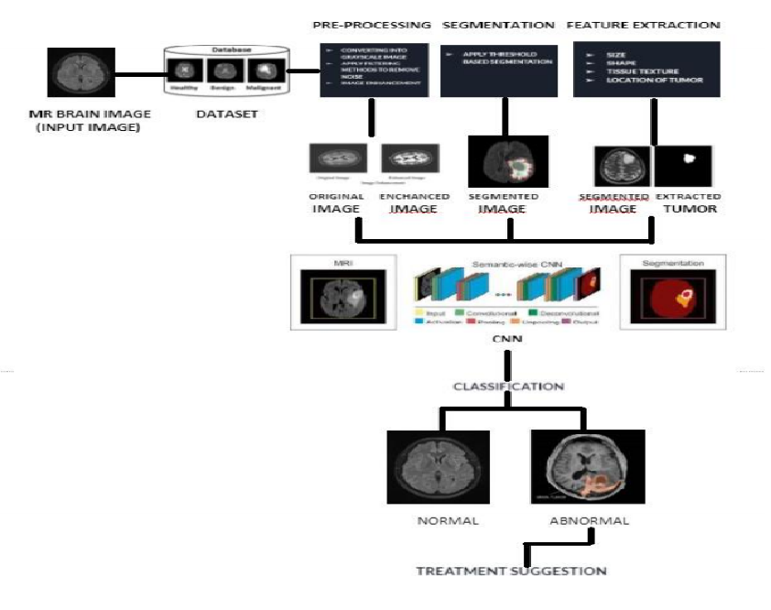
SYSTEM ARCHITECTURE

Slide 9
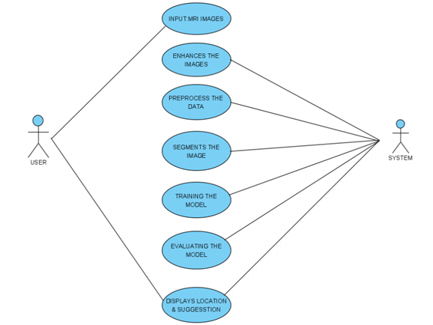
SYSTEM DESIGN
(UML DIAGRAMS)
USECASE DIAGRAM

Slide 10
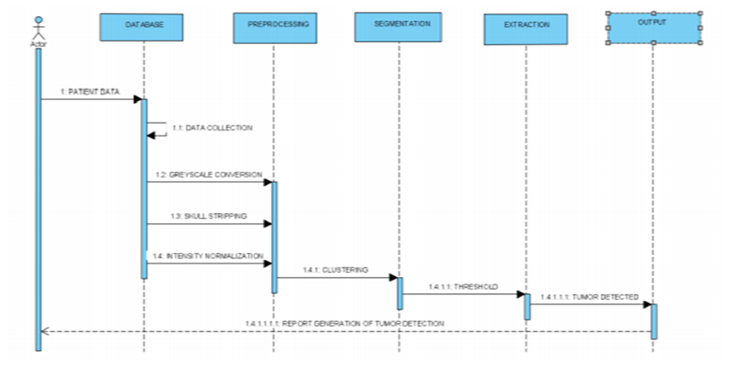
SEQUENCE DIAGRAM

Slide 11
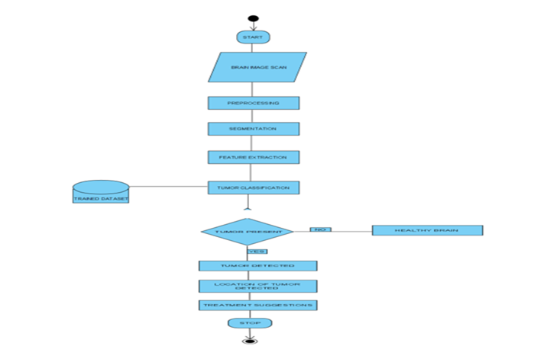
ACTIVITY
DIAGRAM

Slide 12
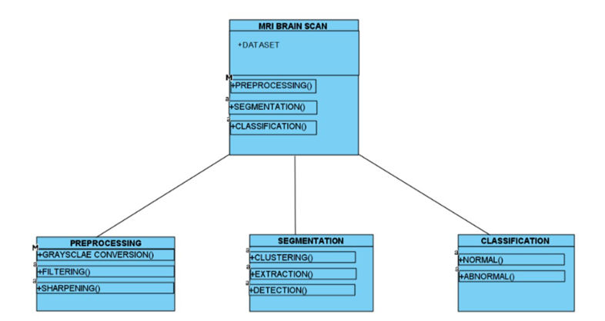
CLASS DIAGRAM

Slide 13
DATASET
Datasets taken from Kaggle-Brats17
Set of MRI images were taken as Dataset
Moreover 253 images were taken and get trained by the system, where 98 images are non-tumorous and 155 images are tumorous.
DATASET LINK: https://www.kaggle.com/navoneel/brain-mri-images-for-brain-tumor-detection

Slide 14
MODULES
Data Pre-Processing
Segmentation
Feature Extraction
Classification
Training and Testing
Treatment Suggestion

Slide 15
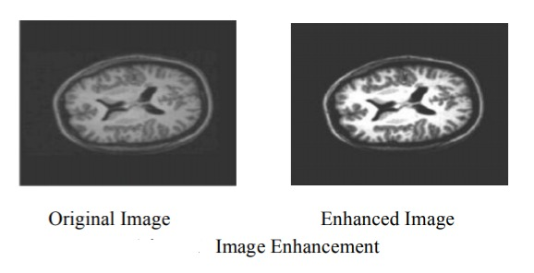
DATA PRE-PROCESSING
MODULE DESCRIPTION
Data collected from various means will be in an unorganized format and there may be lot of null values, in-valid data values.
Cleaning all these data and replacing them with appropriate or approximate data, removing null, missing data and replacing them with some fixed alternate values are the basic steps in pre-processing of data.
Every cases must be verified and replaced with meaningful data and useful for further processing.
Data must be kept in an organized format.

Slide 16
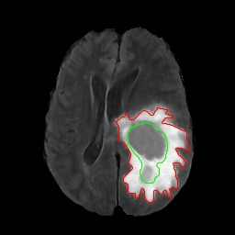
SEGMENTATION
Segmentation technique is to separate out tumor region from MRI image.
Using segmentation it is possible to identify objects, boundaries, location in an image.
It is used to achieve the goal to obtain the more meaningful and easier to analyze an image as it simply change the image representation.
SEGMENTED IMAGE

Slide 17
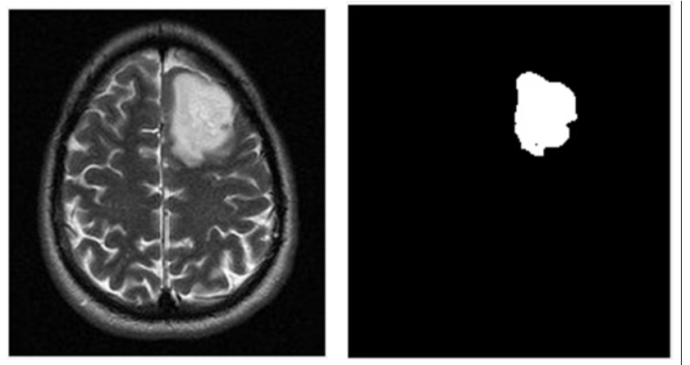
FEATURE EXTRACTION
Feature extraction is the process of extracting the features of segmented brain tumor.
It is a crucial task in case of brain tumor because of the complex structure of brain.
Certain parameters are taken into account for feature extraction as size, shape, composition, location of image.
EXTRACTED TUMOR

Slide 18
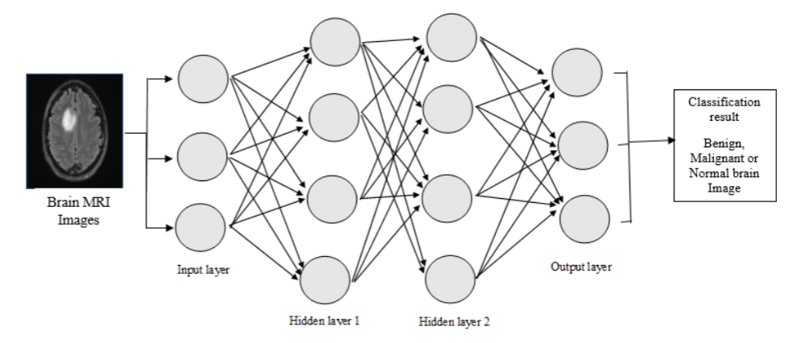
CLASSIFICATION
Image classification is a process of classifying the items according to its type and pattern from the image in the dataset.
Image classification is performed using CNN algorithm.
CNN algorithm is used to classify it into normal brain or tumor brain.
For example, if we have an MRI brain image and we need to train our CNN on that image to classify it into “normal brain” or “tumor brain”.
CLASSIFICATION USING CNN

Slide 19
TRAINING AND TESTING
Finally after processing of data , the very next task is training and testing.
This is where performance of the algorithm, quality of data, and required output all appears out.
From the huge data set collected 70 percent of the data is utilized for training and 30 percent of the data is reserved for testing.
Training is the process of making the machine to learn and giving it the capability to make further predictions based on the training it undergone.
Testing means having a predefined data set, the model is tested whether it is working properly or not and is giving the right prediction or not.
If maximum number of predictions are right then model will have a good accuracy percentage and is reliable to continue with otherwise better to change the model.

Slide 20
TREATMENT SUGGESTION
Treatment suggestions includes types of treatment that are the standard of care for a brain tumor.“Standard of Care” means the best treatments known.
Treatment for a brain tumor depends on size, type and location of the tumor cells.
Treatment includes surgery,radiation and chemotherapy.
Surgery
If the tumor located in place that makes accessible for an operation,the surgeon will work to remove the tumor cells as much as possible
Radiation
This therapy uses high energy beams like X-rays or protons to kill tumor cells.It may cause many side effects also.
Chemotherapy
Under this therapy,doctors uses drugs like temozolomide(temodar),which is taken as pill.

Slide 21
REHABILITATION AFTER TREATMENT
There is a need for rehabilitation because brain tumors can develop in parts of the brain that control motor skills,speech,vision and thinking.
Physical therapy to help you regain lost motor skills or muscle strength
Occupational therapy to help you get back to your normal daily activities, including work, after a brain tumor or other illness
Speech therapy with specialists in speech difficulties (speech pathologists) to help if you have difficulty speaking
Tutoring for school-age children to help kids cope with changes in their memory and thinking after a brain tumor

Slide 22
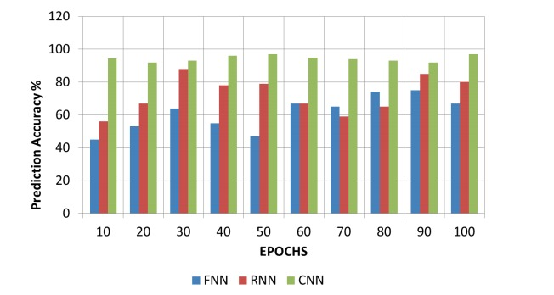
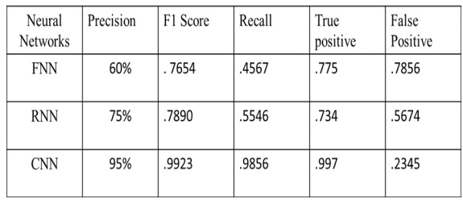
PERFORMANCE EVALUATION
PERFORMANCE GRAPH ON VARIOUS CLASSIFIERS
EVALUATION METRICS ON VARIOUS NEURAL NETWORKS

Slide 23
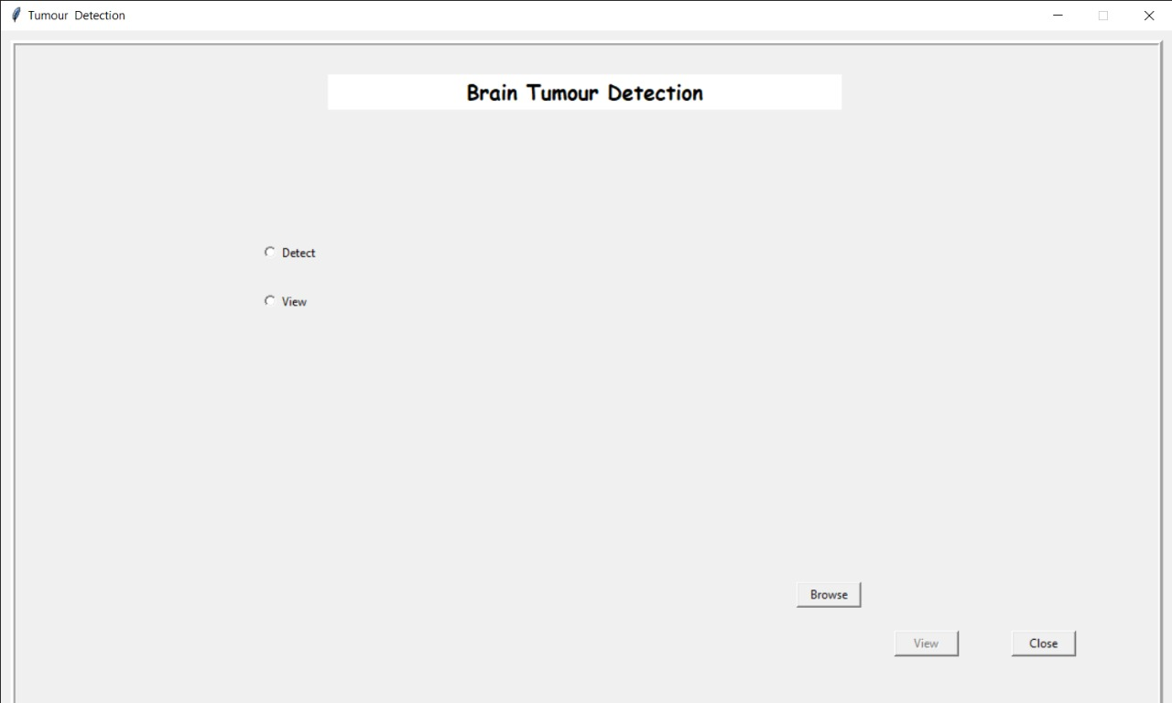
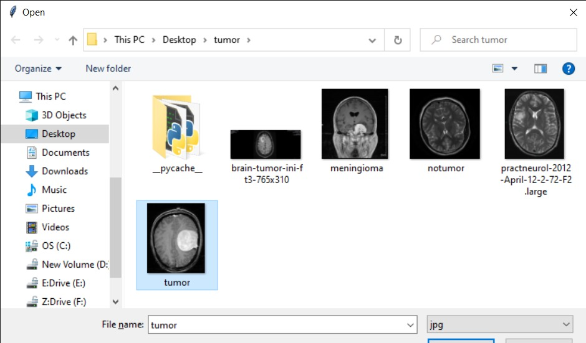
SCREEN SHOTS

Slide 24
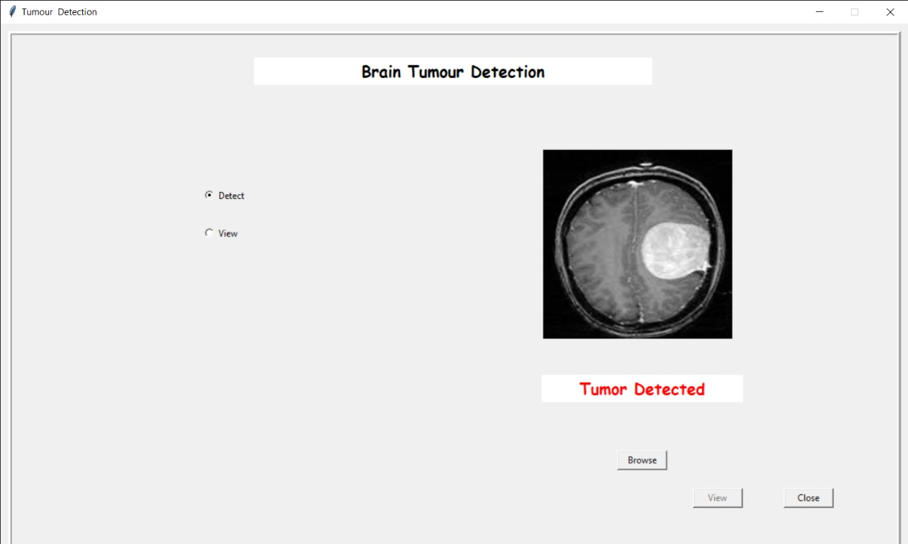

Slide 25


Slide 26
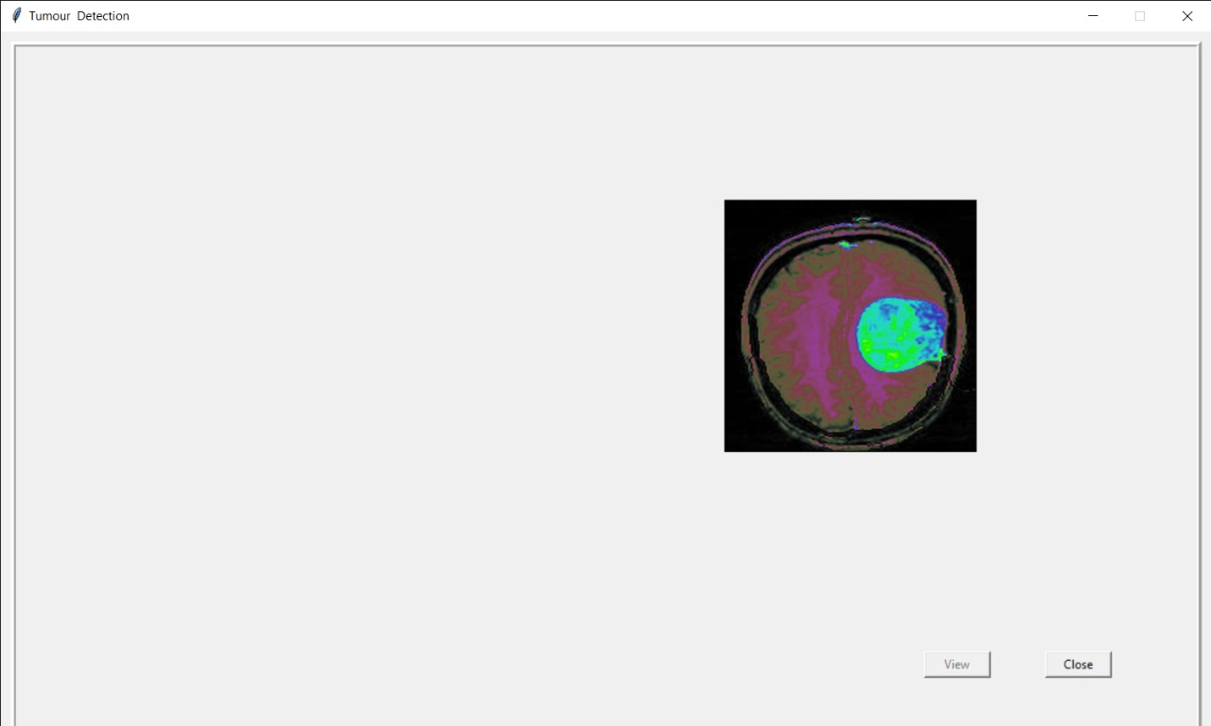

Slide 27
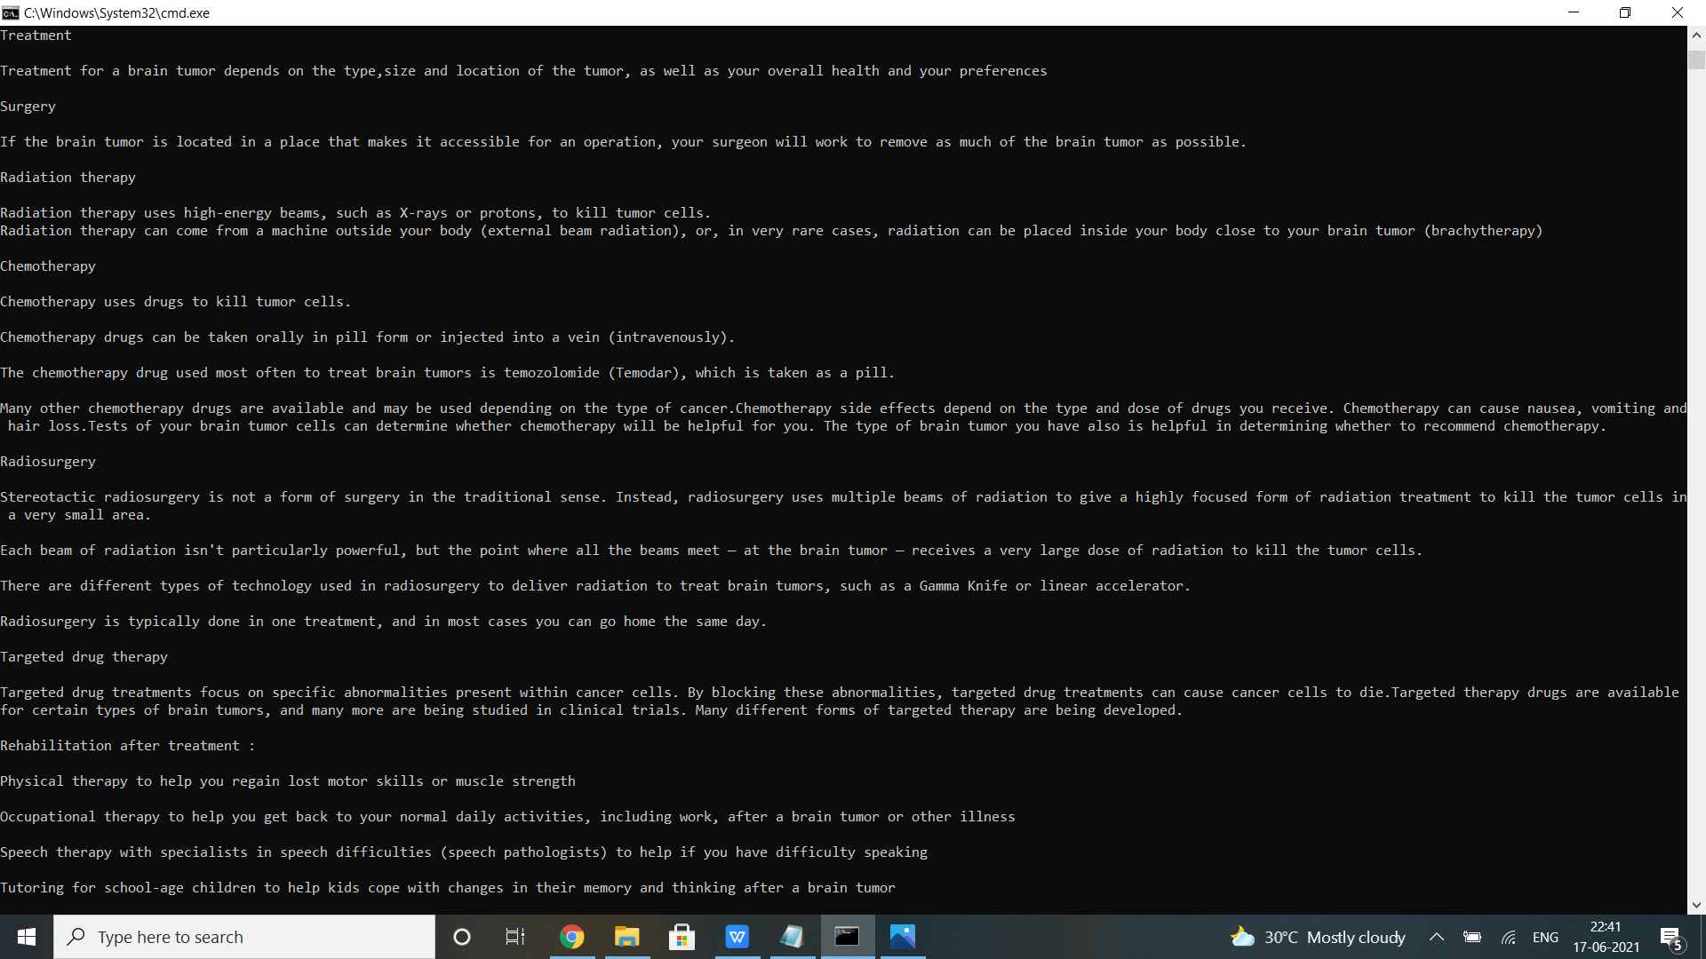

Slide 28
CONCLUSION
We have proposed a recommender system which helps physicians to detect the presence and location of tumour..
In this recommender system, a deep learning algorithm have been used called CNN which is the best algorithm for image recognition,since this system takes input in image format i.e jpeg or jpg .
Initially,image processing techniques are done by taking input MR image for enhancement of image quality and to detect and classify MR image into benign and malignant using a proposed CNN algorithm for accurate detection of brain tumor and giving treatment suggestions based on needs.
By using this methodology, we improve the efficiency of detection and classification of brain tumors via MR Images.
For physicians, it works like an add on, which reduces their work and time.

Slide 29
PUBLICATION DETAILS
Journal Name : International Journal of Creative Research Thoughts (IJCRT)
Paper Title : Artificial Intelligence Recommendation System For Cancer Rehabilitation Scheme
Published in : Volume 9 | Issue 5 | May 2021
Link : http://www.ijcrt.org/papers/IJCRT2105896.pdf

Slide 30
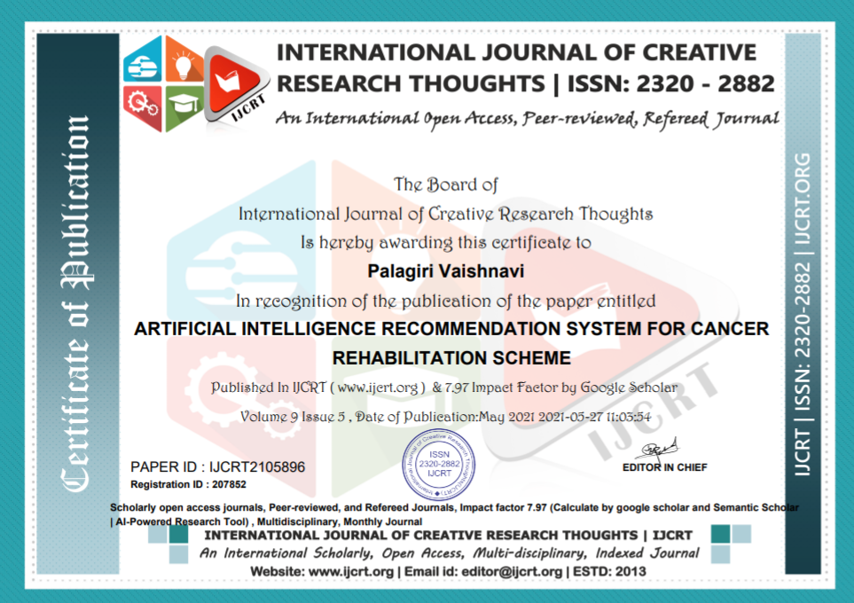
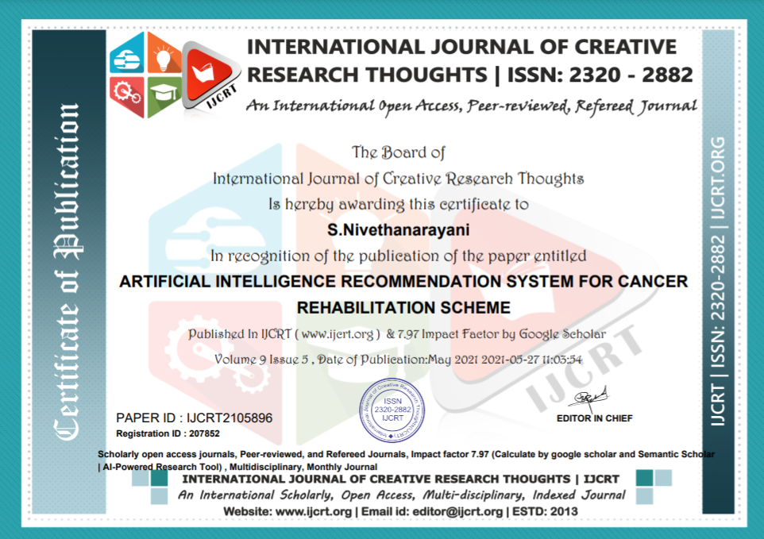

Slide 31
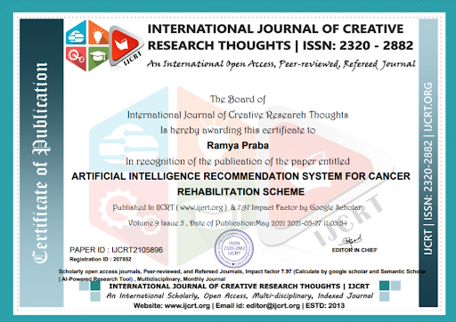

Slide 32
REFERENCES
[1] C. F. Pasluosta, H. Gassner, J. Winkler, J. Klucken, and B. M. Eskofier, ‘‘An emerging era in the management of Parkinson’s disease: Wearable technologies and the Internet of Things,’’ IEEE J. Biomed. Health Informat., vol. 19, no. 6, pp. 1873– 1881, Nov. 2015, doi: 10.1109/ JBHI.2015.2461555.
[2] De Luca et al., “Now you see me, now you don’t: Protecting smartphone authentication from shoulder surfers,” in Proc. SIGCHI Conf. Human Factors Comput. Syst., Toronto, ON, Canada, May 2014,pp. 2937–2946.
[3] J. Aviv, K. Gibson, E. Mossop, M. Blaze, and J. M. Smith, “Smudge attacks on smartphone touch screens,” in Proc. 4th USENIX Conf.Offensive Technol., Berkeley, CA, USA, 2010, pp. 1–7.
[4] S. Cha, S. Kwag, H. Kim, and J. H. Huh, “Boosting the guessing attack performance on Android lock patterns with smudge attacks,” in Proc. ACM Asia Conf. Comput. Commun. Secur., Abu Dhabi, United Arab Emirates, Apr. 2017, pp. 313–326.
[5] Maiti, M. Jadliwala, J. He, and I. Bilogrevic, “(Smart)watch your taps: Side-channel keystroke inference attacks using smartwatches,” in Proc. ACM Int. Symp. Wearable Comput., Osaka, Japan, Sep. 2015,pp. 27–30.
[6] L. JabaSheela and Dr.V. Shanthi “Image Mining Techniques For Classification And Segmentation Of Brain MRI Data,” Journal of Theoretical and Applied Information Technology,vol.3,Issue.4, Dec. 2007.
[7] P. Vijayalakshmi, K. Selvamani and M. Geetha “Segmentation Of Brain MRI Using K-Means Clustering Algorithm,” International Journal of Engineering Trends and Technology, vol.3, pp. 113- 115, 2011.

Slide 33
THANK YOU : )

